Slide 1
CSE 225
Queue, Deque and Priority Queue

Slide 2
Queues, and Deques
A queue is a first in, first out (FIFO) data structure
Items are removed from a queue in the same order as they were inserted
A deque is a double-ended queue—items can be inserted and removed at either end

Slide 3
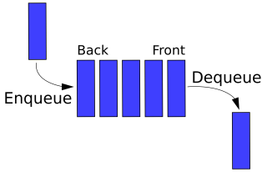
Queue Operations
Enqueue() : Add an element to the rear of the queue.
Dequeue() : Remove and returns the element at the front of the queue.
isEmpty() : returns true if queue is empty.
isFull() : returns true if queue is full.

Slide 4
Array implementation of queues
A queue is a first in, first out (FIFO) data structure
This is accomplished by inserting at one end (the rear) and deleting from the other (the front)
0 1 2 3 4 5 6 7
myQueue:
17
23
97
44
front = 0
rear = 3
To insert: put new element in location 4, and set rear to 4
To delete: take element from location 0, and set front to 1

Slide 5
Array implementation of queues
front = 0
rear = 3
Initial queue:
17
23
97
44
After insertion:
17
23
97
44
333
After deletion:
23
97
44
333
front = 1
rear = 4
Notice how the array contents “crawl” to the right as elements are inserted and deleted
This will be a problem after a while!

Slide 6
Enqueue()
Inserting 15
The queue insert operation is known as enqueue.
Rear
0 1 2 3 4 5 6 7
Front
Front=0
Rear=0

Slide 7
Enqueue()
Inserting 23
Rear
0 1 2 3 4 5 6 7
15
Front
Front= 0
Rear= 1

Slide 8
Enqueue()
Inserting 44
Rear
0 1 2 3 4 5 6 7
15
23
Front
Front= 0
Rear= 2

Slide 9
Enqueue()
Inserting 56
Rear
0 1 2 3 4 5 6 7
15
23
44
Front
Front= 0
Rear= 3

Slide 10
Enqueue()
Inserting 63
Rear
0 1 2 3 4 5 6 7
15
23
44
56
Front
Front= 0
Rear= 4

Slide 11
Enqueue()
Inserting 70
Rear
0 1 2 3 4 5 6 7
15
23
44
56
63
Front
Front= 0
Rear= 5

Slide 12
Enqueue()
Inserting 87
Rear
0 1 2 3 4 5 6 7
15
23
44
56
63
70
Front
Front= 0
Rear= 6

Slide 13
Enqueue()
Inserting 99
Rear
0 1 2 3 4 5 6 7
15
23
44
56
63
70
87
Front
Front= 0
Rear= 7

Slide 14
Enqueue()
Inserting 99
Rear
0 1 2 3 4 5 6 7
15
23
44
56
63
70
87
99
Front
Front= 0
Rear= 8, Queue Full

Slide 15
Dequeue()
The queue delete operation is known as dequeue.
Deleting 15
Rear
0 1 2 3 4 5 6 7
15
23
44
56
63
70
87
99
Front
Front= 0
Rear= 8

Slide 16
Dequeue()
Deleting 23
Rear
0 1 2 3 4 5 6 7
23
44
56
63
70
87
99
Front
Front= 1
Rear= 8

Slide 17
Dequeue()
Deleting 44
Rear
0 1 2 3 4 5 6 7
44
56
63
70
87
99
Front
Front= 2
Rear= 8

Slide 18
Dequeue()
Deleting 56
Rear
0 1 2 3 4 5 6 7
56
63
70
87
99
Front
Front= 3
Rear= 8

Slide 19
Dequeue()
Deleting 63
Rear
0 1 2 3 4 5 6 7
63
70
87
99
Front
Front= 4
Rear= 8

Slide 20
Dequeue()
Deleting 70
Rear
0 1 2 3 4 5 6 7
70
87
99
Front
Front= 5
Rear= 8

Slide 21
Dequeue()
Deleting 87
Rear
0 1 2 3 4 5 6 7
87
99
Front
Front= 6
Rear= 8

Slide 22
Dequeue()
Deleting 99
Rear
0 1 2 3 4 5 6 7
99
Front
Front= 7
Rear= 8

Slide 23
Dequeue()
Rear
0 1 2 3 4 5 6 7
Front
Front= 8
Rear= 8

Slide 24
IsEmpty()
Empty Queue
0 1 2 3 4 5 6 7
When, Front = Rear, it is an empty queue.

Slide 25
Circular arrays
We can treat the array holding the queue elements as circular (joined at the ends)
0 1 2 3 4 5 6 7
myQueue:
44
55
11
22
33
rear = 1
front = 5
Elements were added to this queue in the order 11, 22, 33, 44, 55, and will be removed in the same order
Use: front = (front + 1) % myQueue.length; and: rear = (rear + 1) % myQueue.length;

Slide 26
Enqueue()
Inserting 9 ,6 ,15 ,26 ,78
Front
7
0
s
9
6
Enqueue()
1
6
15
5
2
78
26
Rear
4
3
Here ,
Rear= 5 & Front = 0

Slide 27
Dequeue()
Deleting 9
7
0
Front
s
6
Dequeue()
1
6
15
5
2
78
26
Rear
4
3
Here ,
Rear= 4 & Front = 1

Slide 28
Full and empty queues
If the queue were to become completely full, it would look like this:
0 1 2 3 4 5 6 7
myQueue:
44
55
66
77
88
11
22
33
rear = 5
front = 5
If we were then to remove all eight elements, making the queue completely empty, it would look like this:
0 1 2 3 4 5 6 7
myQueue:
rear = 5
front = 5
This is a problem!

Slide 29
Full and empty queues: solutions
Solution #1: Keep an additional variable
0 1 2 3 4 5 6 7
myQueue:
44
55
66
77
88
11
22
33
count = 8
rear = 5
front = 5
Solution #2: (Slightly more efficient) Keep a gap between elements: consider the queue full when it has n-1 elements
0 1 2 3 4 5 6 7
myQueue:
44
55
66
77
11
22
33
rear = 4
front = 5

Slide 30
a priority queue is an abstract data type which is like a regular queue or stack data structure, but where additionally each element has a "priority" associated with it.
Priority Queue
In a priority queue, an element with high priority is served before an element with low priority. If two elements have the same priority, they are served according to their order in the queue.

Slide 31
Insertion Operation
Head
prio
data
add
1
40
3
50
4
20
NULL
Head (front)
Tail (rear)

Slide 32
Insertion Operation
Inserting 87 with priority 2
Head
1
40
3
50
4
20
NULL
2
87
Front
Rear
(Inserting)

Slide 33
Insertion Operation
Inserting 87 with priority 2
2
87
Head
1
40
2
87
3
20
4
20
NULL
Front
Data will be inserted
Rear

Slide 34
Deletion Operation
Normally Deletion operation occurs at head pointer
Head
1
40
2
87
3
50
Front
4
20
NULL
Rear

Slide 35
Deletion Operation
Head
2
87
3
50
4
20
NULL
Front
Rear

Slide 36
Deques
A deque is a double-ended queue
Insertions and deletions can occur at either end
Implementation is similar to that for queues
Deques are not heavily used
You should know what a deque is, but we won’t explore them much further

Slide 37
Insertion at Front
Create a Node containing data and then point it to the node which is pointed to the head pointer.
Then head pointer will point the created node.
Head
data
add
40
50
20
NULL
Insert
Front
Rear

Slide 38
Insertion at Rear
Create a Node containing data and then point it to the node which is pointed to the head pointer if head is NULL otherwise , check till the NULL pointer and then insert at that pointer.
Head
data
add
Insert
40
50
20
NULL
Front
Rear

Slide 39
Deletion Operation at Front
Create a node temp then point it to head .Then head will
point to head->next .
Then we have to free temp.
data
add
Delete
Head
40
50
20
NULL
Front
Rear

Slide 40
Deletion Operation at Rear
If head is NULL then queue is empty.
If head->next is NULL then head=NULL.
Otherwise, create a node temp.Then, we will check temp->next->next .If it is not
NULL then we will set temp= temp->next. Then if we find NULL then we
free(temp->next).
Head
data
add
40
50
20
NULL
Delete
Front
Rear

Slide 41
QUEUING THEORY
Queuing Theory is a field of applied mathematics and computer science that is used to predict the performance of queues

Slide 42
Queuing Theory
A single-server queue can provide service to only one customer at a time (hot food vendor on street corner).
A multi-server queue can provide service to many customers at a time (bank, post-office).
Multiqueues – multiple single-server queues (a grocery store).
A customer is any person or thing needing the service.
The service is any activity needed to accomplish the required result.

Slide 43
Queuing Theory
The rate at which customers arrive in the queue for service is known as the arrival rate. It may be random or regular.
Service time is the average time required to complete the processing of a customer request.

Slide 44
Queuing Theory
In an ideal situation, customers would arrive at a rate that matches the service time.
However, things are seldom ideal. Sometimes the server can be idle because there are no customers to be served. At other times there will be many customers to be served.
If we can predict the patterns, we may be able to minimize idle servers and waiting customers.

Slide 45
Queuing Theory
One of the main tasks in Queuing Theory is to predict such patterns.
Specifically, it attempts to predict queue time (which is defined as the average length of time customers wait in the queue), the average size of the queue, and the maximum queue size.
These predictions are based on the two factors: the arrival rate and the average service time (the average of the total service time between idle periods)

Slide 46
Queuing Theory
Given queue time and service time, we know response time, - a measure of the average time from the point at which customers enter the queue until the moment they leave the server.

Slide 47
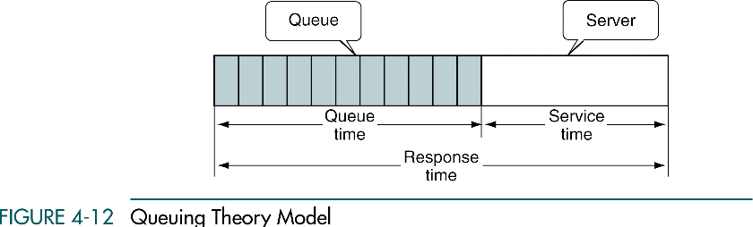

Slide 48
Queuing Theory
The two factors that most affect the performance of queues are the arrival rate and the service time.

Slide 49
4-5 Queue Applications
We develop two queue applications. The first shows how to use a
queue to categorize data. The second is a queue simulator, which is an excellent tool to simulate the performance and to
increase our understanding of its operation.
Categorizing Data
Queue Simulation

Slide 50
Categorizing Data
Categorizing Data is the rearrangement of data without destroying their basic sequence.
As an example: suppose, it is necessary to rearrange a list of numbers grouping them, while maintaining original order in each group (multiple-queue application).

Slide 51
Categorizing Data
Initial list of numbers:
3 22 12 6 10 34 65 29 9 30 81 4 5 19 20 57 44 99
We need to categorize them into four different groups:
Group 1: less than 10
Group 2: between 10 and 19
Group 3: between 20 and 29
Group4: 30 and greater
| 3 6 9 4 5 | 12 10 19 | 22 29 20 | 34 65 30 81 57 44 99

Slide 52
Categorizing Data
The solution: we build a queue for each of the four categories. We than store the numbers in the appropriate queue as we read them.
After all the data have been processed, we print each queue to demonstrate that we categorized data correctly.

Slide 53
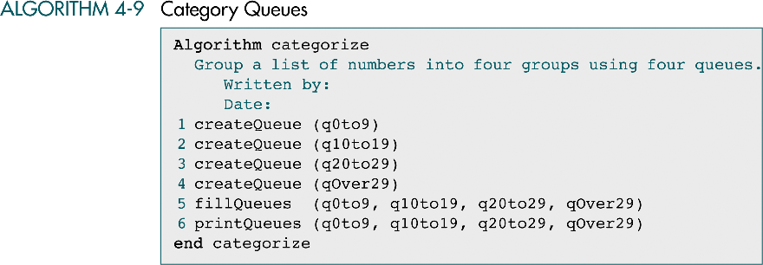

Slide 54
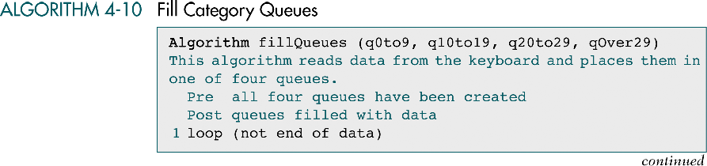

Slide 55
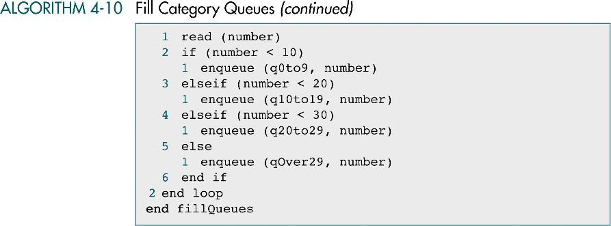

Slide 56
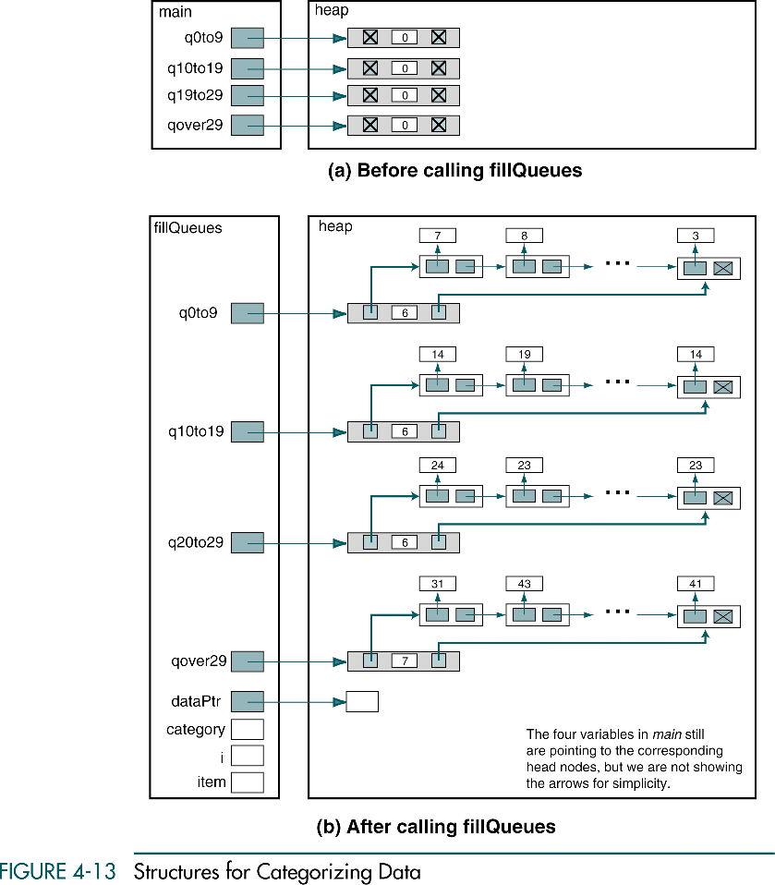

Slide 57
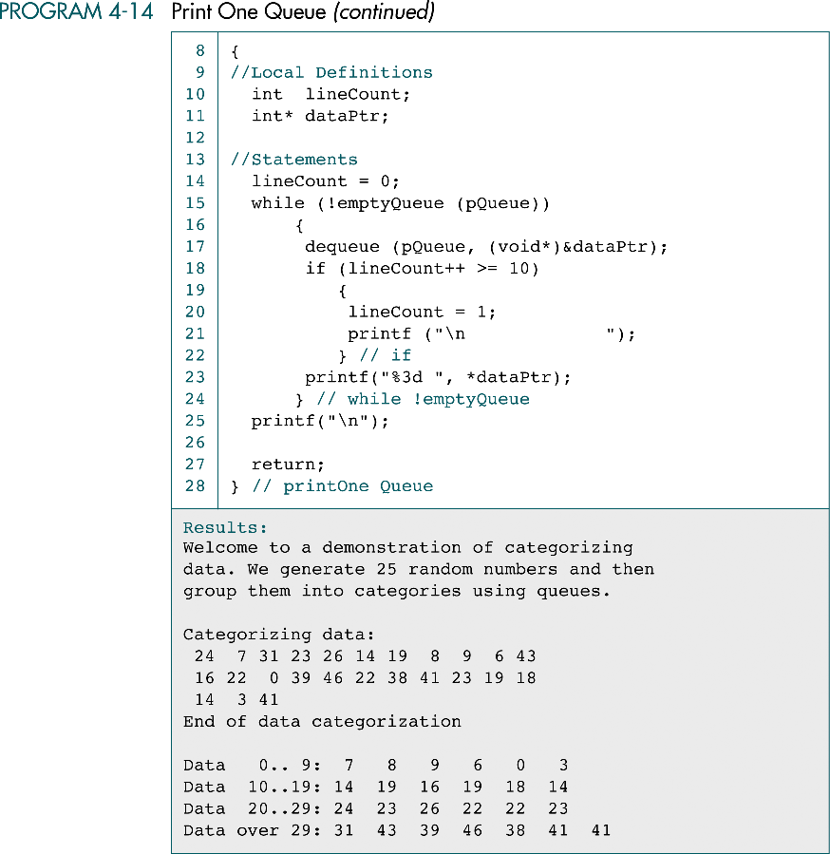

Slide 58
(Continued)

